Slide 1
AML Mini-Project
Sentiment Analysis On Food Review
Aniket Kumar - PF45 (30)
Mandar Kulkarni - PF16 (8)
Madhur Maheshwari - PB61(46)
Kargil Thakur - PE25(15)

Slide 2
Introduction
Sentiment analysis of reviews is a popular task in natural language processing. In this work, the goal is to predict the score of food reviews on a scale of 1 to 5.
We could use the Score/Rating. A rating of 4 or 5 could be considered a positive review. A review of 1 or 2 could be considered negative. A review of 3 is ignored as it can be positive or negative and that can impact our model accuracy. This is an approximate and proxy way of determining the polarity (positivity/negativity) of a review.

Slide 3
Data-Set
This dataset consists of reviews of fine foods from amazon. The data span a period of more than 10 years, including all ~500,000 reviews up to October 2012. Reviews include product and user information, ratings, and a plain text review. It also includes reviews from all other Amazon categories.
Number of reviews: 568,454
Number of users: 256,059
Number of products: 74,258
Timespan: Oct 1999 - Oct 2012
Number of Attributes/Columns in data: 10

Slide 4
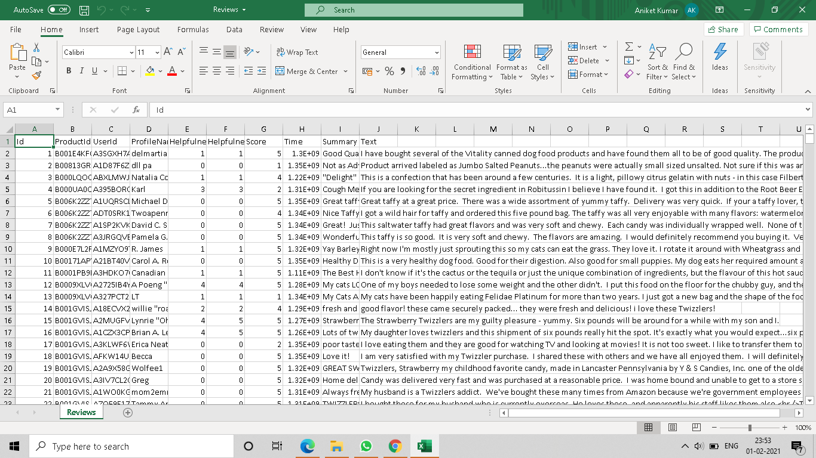

Slide 5
Cont. Data-Set
Size: 287Mb
10 columns and around 5 lakhs rows
Attribute Information:
Id
ProductId - unique identifier for the product
UserId - unqiue identifier for the user
ProfileName
HelpfulnessNumerator - number of users who found the review helpful
HelpfulnessDenominator - number of users who indicated whether they found the review helpful or not
Score - rating between 1 and 5
Time - timestamp for the review
Summary - brief summary of the review
Text - text of the review

Slide 6
Project Contains
EDA
NLP
Text Preprocessing
Visualization

Slide 7
Thank You!!!

